Slide 1
Improve usage of unsupervised data for the definition of RUL-based maintenance policies
Professor:
Michele Lombardi
Presented By:
Davide Angelani
Yellam Naidu Kottavalasa
Usha Padma Rachakonda

Slide 2
Introduction
Remain useful Life refers to the remaining time of a machine before it requires a replacement. The prediction of the RUL helps to delay maintenance operations until they are really needed.
To produce robust and trustworthy prediction we need a lot of data about lifespan of the machine until its failure. The problem is that to produce data in large quantity is generally expensive and time consuming.
Despite the small amount of run-to-failure experiments, we have a lot of data about the normal functioning of the machines.
We propose a semi-supervised approach for estimating Remain Useful Life. In particular, we inject external knowledge about the problem in the form of constraint.

Slide 3
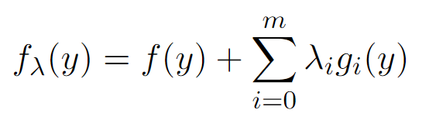
Semantic-based regularizer
We model our constraint by the mean of a Semantic-based regularizer. This approach consists of extending the learning task with a set of constraint.
λ measure the penalty introduced by violating the constraint.

Slide 4
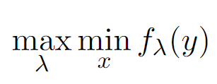
Lagrangian Dual Framework
To choose the right λ we use the Lagrangian Duality.
We are interested in minimizing f(y) and maximizing λg(y), if we consider the dual function the problem become:
In this way we can get the strongest Lagrangian relaxation of the original problem.

Slide 5

Monotone behaviour
After each time step, we can notice that the RUL value decrease by a number of units corresponding to the time step elapsed.
Therefore, the RUL preserves a non-increasing behaviour and we can exploit this property by defining the constraint

Slide 6
Dataset
Commercial Modular Aero-Propulsion System Simulation (C-MAPSS), which was developed by NASA.
The dataset consists of 4 training set files and 4 test set files.
The sub-datasets are composed of multivariate temporal data obtained from 21 sensors.
Dataset | FD001 | FD002 | FD003 | FD004
Training Trajectories | 100 | 260 | 100 | 248
Test Trajectories | 100 | 259 | 100 | 248
Operating Conditions | 1(sea level) | 6 | 1(Sea level) | 6
Fault Modes | HPC | HPC | HPC, Fan | HPC, Fan

Slide 7
Dataset Generation
We define a series of ratios in which the data set will be split into the supervised training set, unsupervised training set, and test set.
The partitions are defined by the mean of the machines, in this way we maintain together with samples from the same machine.
The size of the test set is fixed to 12% for all the experiments.
% | No.Of Supervised Machine/Samples | No.Of Unsupervised Machine/Samples | No.Of Test Machine/Samples
3%/75% | 7/1548 | 186/45470 | 56/14231
23%/ 55% | 57/13367 | 136/33651 | 56/14231
43%/ 35% | 107/25853 | 87/21505 | 55/13891
63% / 15% | 156/38215 | 37/8803 | 56/14231

Slide 8
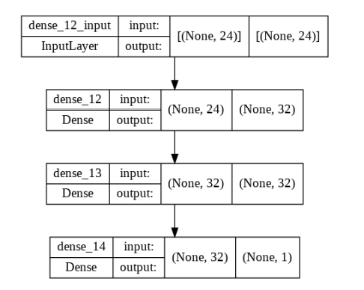
Baseline Model
We have defined our baseline model as a network of two hidden layers of 32 neurons.

Slide 9
Experiments
We define four model:
the first model is the baseline model.
the second model applies the semantic-based regularizer with a fixed constraint equal to 1.
the third model applies both the semantic-based regulazer and the penalty term is chosen using the Lagrangian Dual Framework. It has a single penalty term computed on the average of all the constraint.
the fourth model applies both the approaches but it has multiple penalty term.

Slide 10
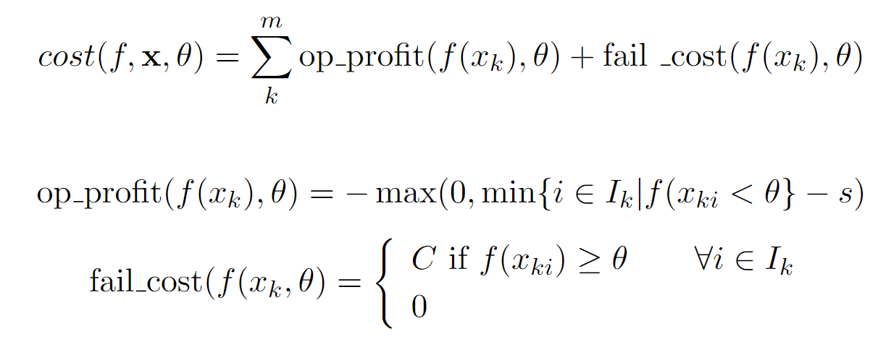
Evaluations
The goal of RUL estimation is not to achieve the best possible accuracy but to save as much as possible.
For a proper evaluation we have defined a cost model.

Slide 11
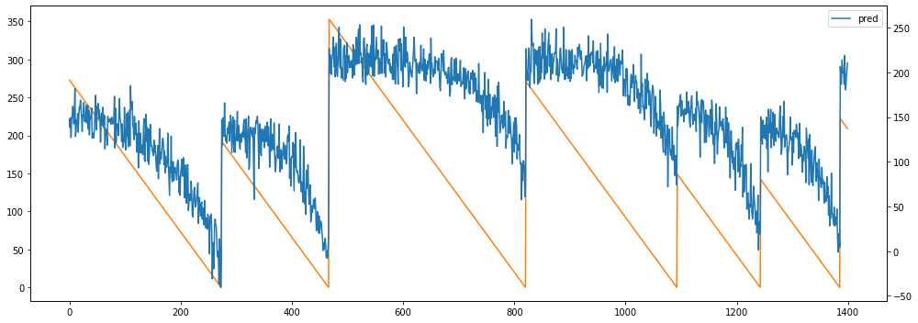
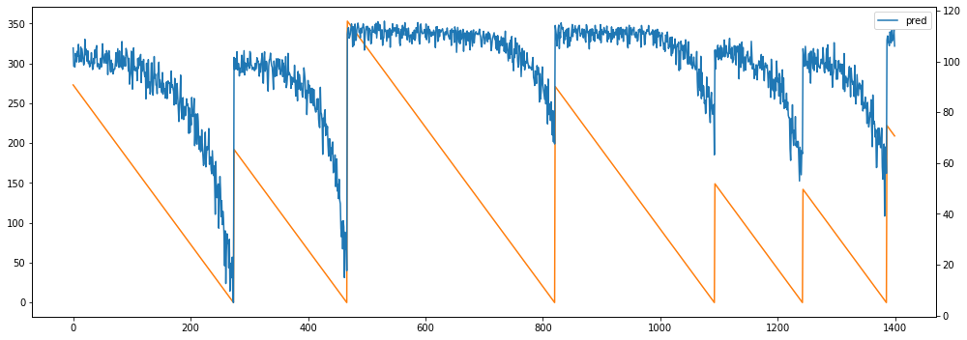
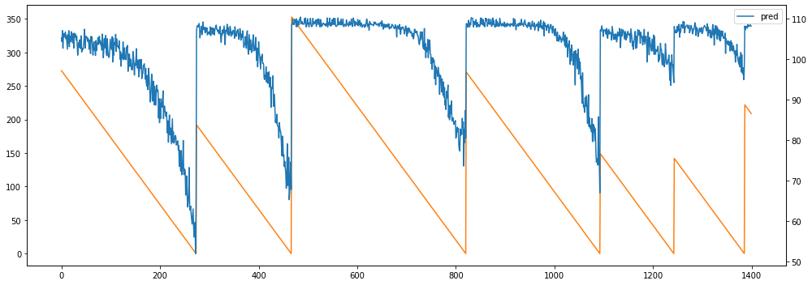
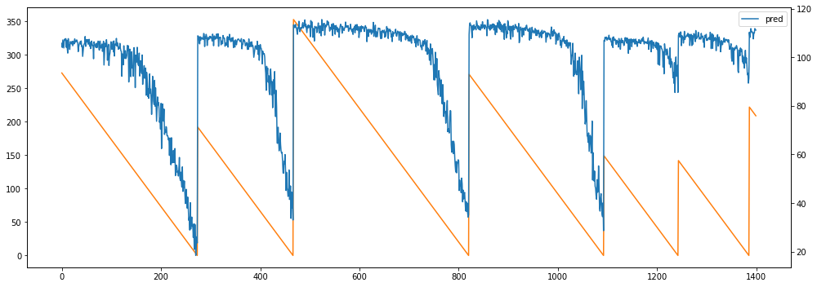
3% supervised 75% unsupervised
(a) Baseline Model
(b) Fixed Regularize
(c) Regularize updated using a Lagrangian dual approach
(d) Multiple regularizes updated using Lagrangian dual

Slide 12
Cost model for the split 3% supervised and 75% unsupervised
 | Base | Fixed Multiplier | Updated Regularize | Multiple Regularize
Cost | -417/35952/9971 | -361/36747/11817 | -29/-2807/-1513 | -51/-3903/-1826
Average fails | 0.00/0.44/0.41 | 0.00/0.44/0.46 | 0.00/0.05/0.04 | 0.00/0.03/0.02
Average slack | 9/8/10 | 17/8/7 | 99/91/97 | 74/99/110

Slide 13
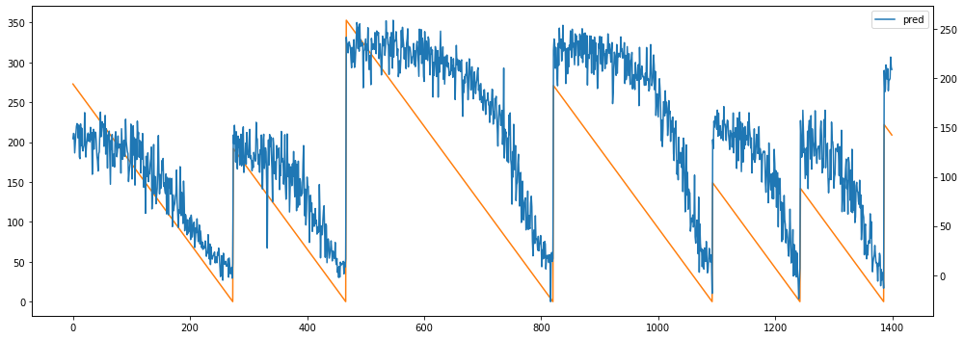
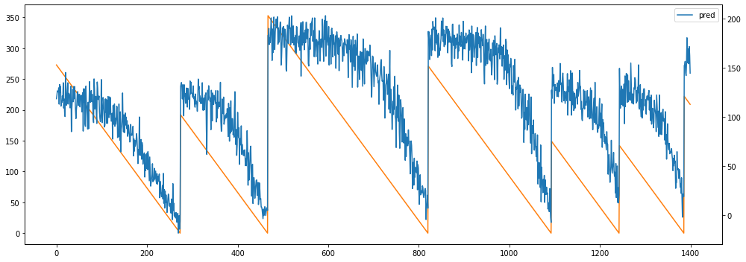
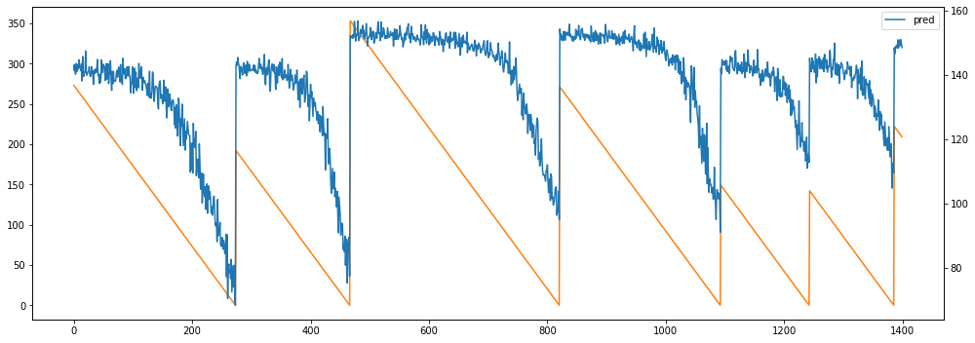
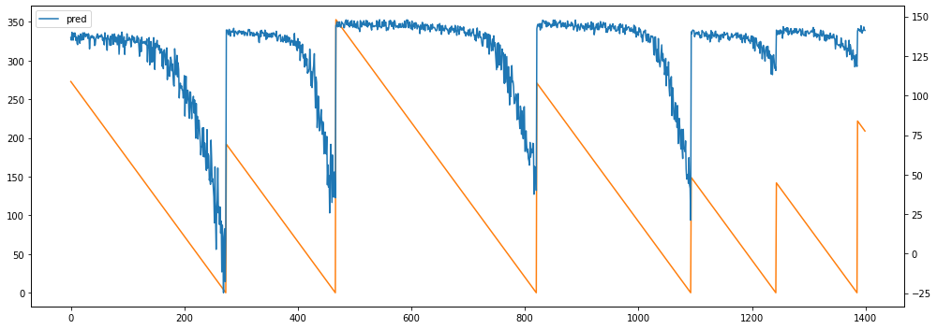
23% supervised 55% unsupervised
(a) Baseline Model
(b) Fixed Regularize
(c) Regularize updated using a Lagrangian dual approach
(d) Multiple regularizes updated using Lagrangian dual

Slide 14
Cost model for the split 23% supervised and 55% unsupervised
 | Base | Fixed Multiplier | Updated Regularize | Multiple Regularize
Cost | -5389/-11835/-5551 | -4853/-13490/-5431 | -3834/-9514/-4864 | -1132/-4224/-1788
Average fails | 0.00/0.02/0.02 | 0.02/0.00/0.02 | 0.02/0.01/0.00 | 0.02/0.01/0.00
Average slack | 18/17/14 | 18/18/17 | 36/39/38 | 106/107/127

Slide 15
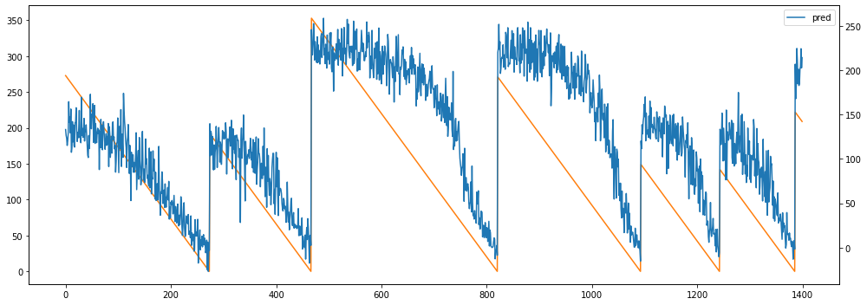
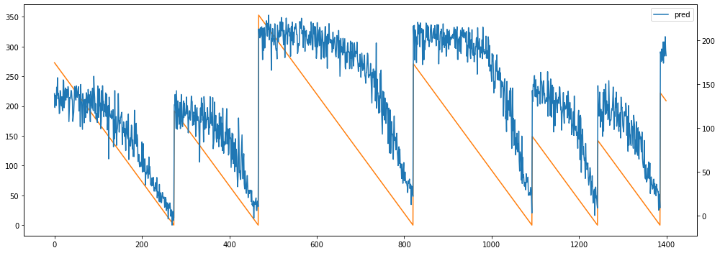
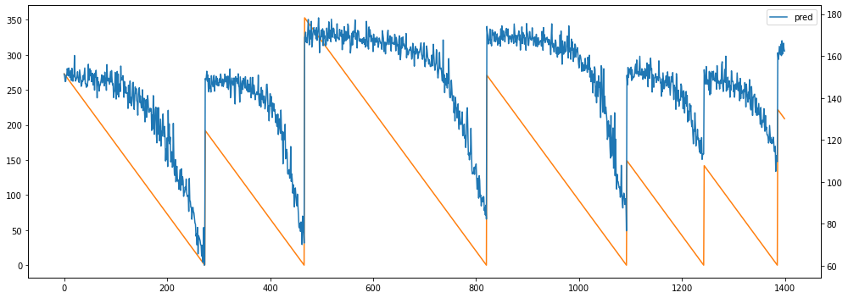
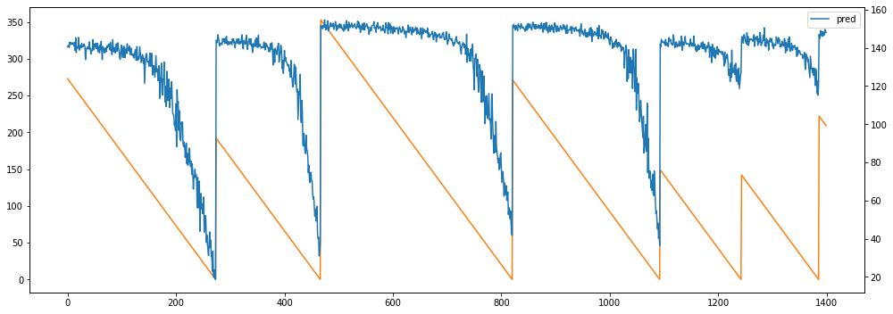
43% supervised 35% unsupervised
(a) Baseline Model
(b) Fixed Regularize
(c) Regularize updated using a Lagrangian dual approach
(d) Multiple regularizes updated using Lagrangian dual

Slide 16
Cost model for the split 43% supervised and 35% unsupervised
 | Base | Fixed Multiplier | Updated Regularize | Multiple Regularize
Cost | -10561/-9053/-5988 | -10141/-7891/-5201 | -8545/-6991/-4753 - | -4099/-4108/-2801
Average fails | 0.00/0.00/0.00 | 0.00/0.01/0.02 | 0.00/0.00/0.00 | 0.00/0.00/0.00
Average slack | 14/17/14 | 18/22/17 | 72/80/80 | 23/18/20

Slide 17
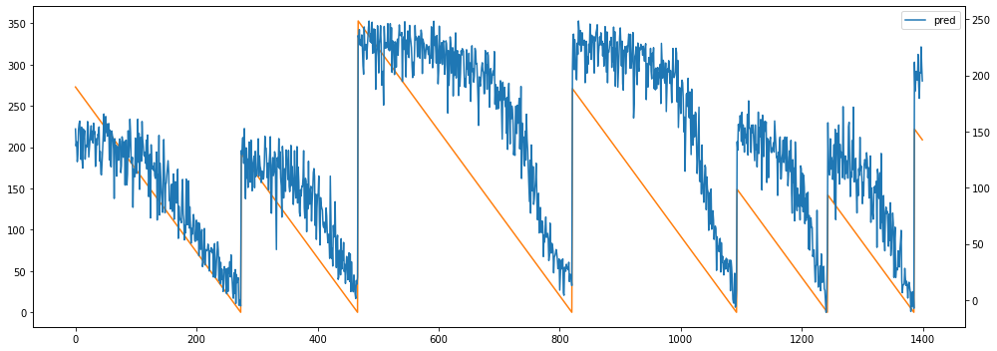
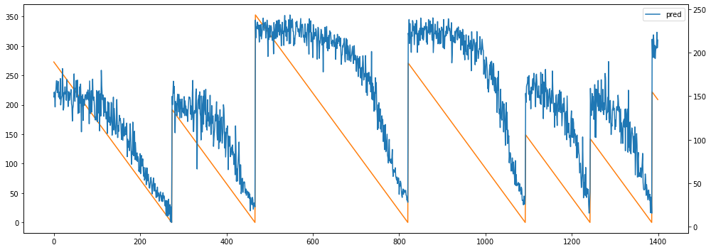
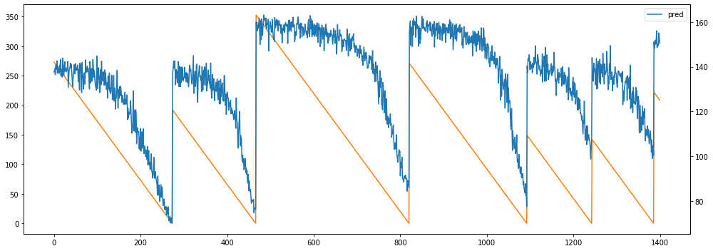
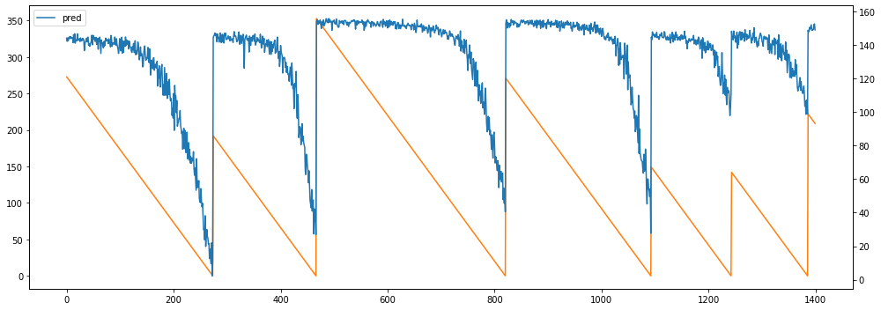
63% supervised 15% unsupervised
(a) Baseline Model
(b) Fixed Regularize
(c) Regularize updated using a Lagrangian dual approach
(d) Multiple regularizes updated using Lagrangian dual

Slide 18
Cost model for the split 43% supervised and 35% unsupervised
 | Base | Fixed Multiplier | Updated Regularize | Multiple Regularize
Cost | -14371/-3029/-5229 | -15200/-3857/-6140 | -13018/-3122/-5170 | -11625/-2802/-4550
Average fails | 0.00/0.00/0.00 | 0.00/0.00/0.00 | 0.00/0.00/0.00 | 0.00/0.00/0.00
Average slack | 24/18/20 | 18/15/15 | 32/35/32 | 41/43/43

Slide 19
Results
As we can see from the tables when the numbers of supervised samples are very low, the baseline model is the worst, with the highest cost and percentage of failure.
Increasing the number of supervised samples helps the baseline model to get better results and outperform the other models.

Slide 20
Conclusion
In this project we have applied a semi-supervised approach for estimating the Remain Useful Life. The approach looks promising when used with a small quantity of supervised data.
The problem is the high average of remaining days to the end-of-life for each machine, predicted by the model on which we have applied the regularizer. This is probably due to the too strictly satisfaction of the constraints but it needs further investigation.

Slide 21
References
Saxena, Abhinav and Kai Goebel (2008). “Turbofan engine degradation simulation data set”. In: NASA Ames Prognostics Data Repository, pp. 1551–3203.
Diligenti, Michelangelo, Marco Gori, and Claudio Sacc`a (2017). “Semantic-based regularization for learning and inference”. In: Artificial Intelligence 244. Combining Constraint Solving with Mining and Learning, pp. 143–16
Fioretto, Ferdinando et al. (2020). “A Lagrangian Dual Framework for Deep Neural Networks with Constraints”. In: CoRR abs/2001.09394

Slide 22


